Slide 1
ASSIGNMENT 04 Name: Amas Waseem Class: BSCS (Morning) Roll no: 35 Seat no: B20102077 Section: A

Slide 2
Practical no: 2
REPRESENATION OF DATA

Slide 3
Data Entry in MATLAB
Data of AGE of 18 students of BSCS class v=[21,22,22,23,25,24,24,22,23,25,20,21,25,24,23,22,21,25]

Slide 4
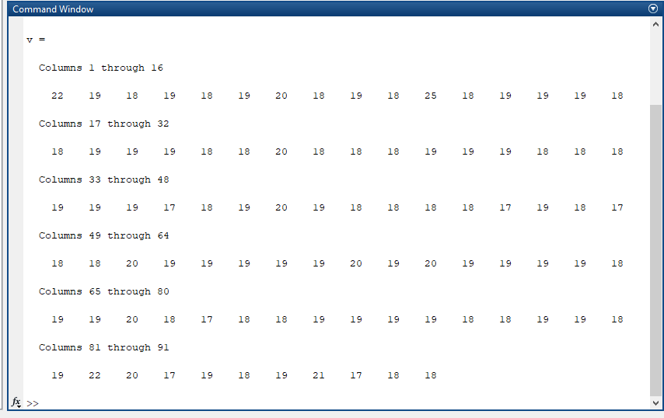
M. Amas Waseem

Slide 5
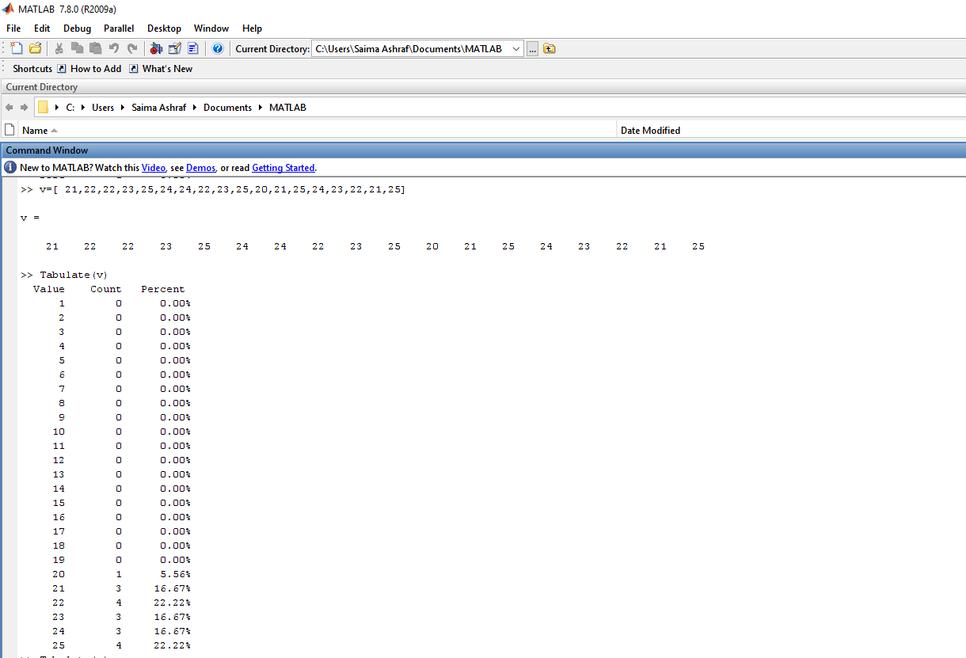
Ungrouped Frequency Or Relative Frequency Distribution
Command: Tabulate(v)

Slide 6
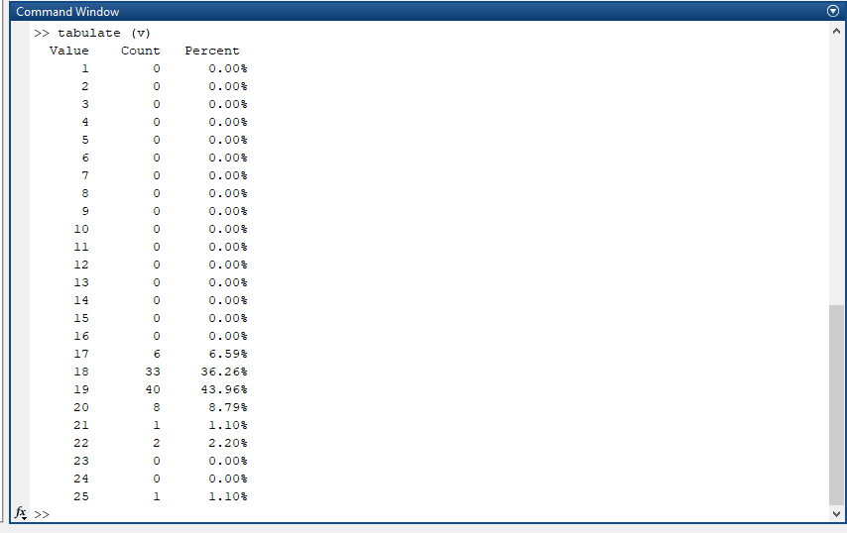
M. Amas Waseem

Slide 7
Grouped Frequency Distribution
Command: L=min value: size of C.I:max value+1
Command: histc(name of variable, lower limit)
L=20:1:26;
F=histc(v,L);

Slide 8
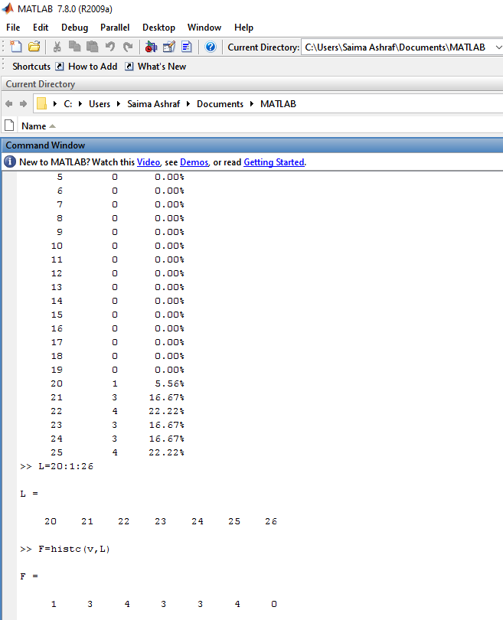
Output

Slide 9

M. Amas Waseem

Slide 10
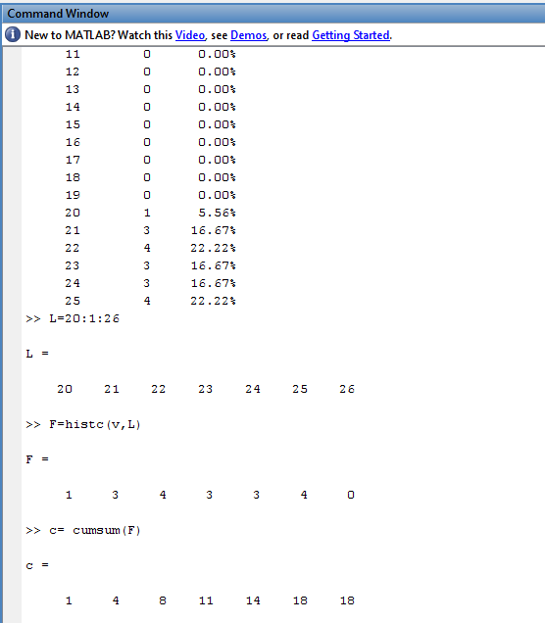
Cumulative Frequency Distribution
Command: c= cumsum(F)

Slide 11
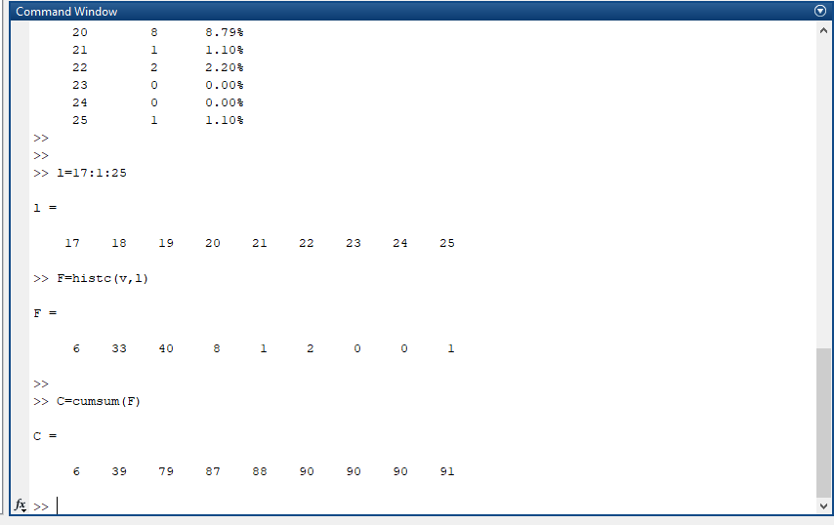
M. Amas Waseem

Slide 12
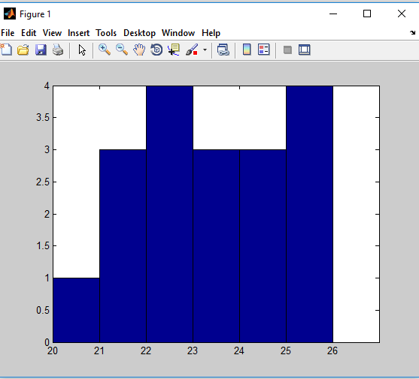
Graphs and Diagrams
Histogram: bar(L,F,'histc')

Slide 13
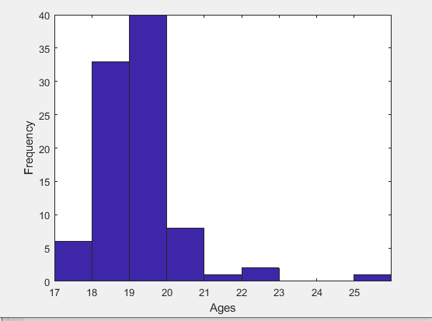
M. Amas Waseem

Slide 14
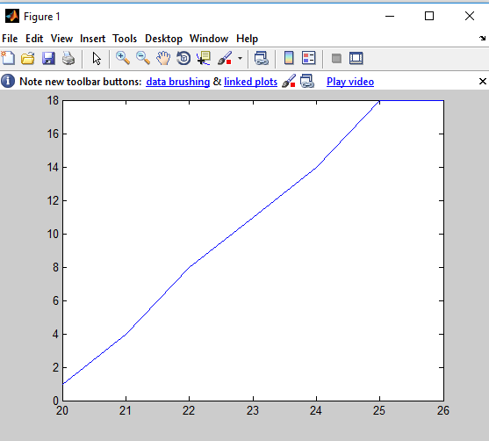
Graphs and Diagrams
Ogive: plot(L,c)

Slide 15
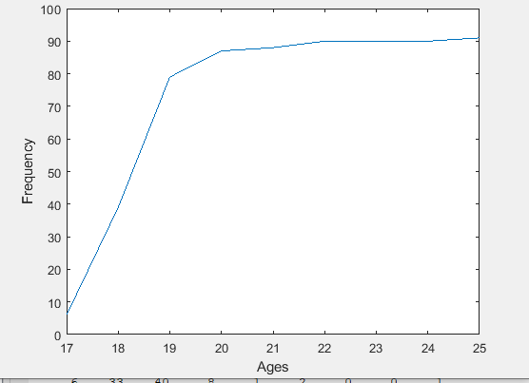
M. Amas Waseem

Slide 16
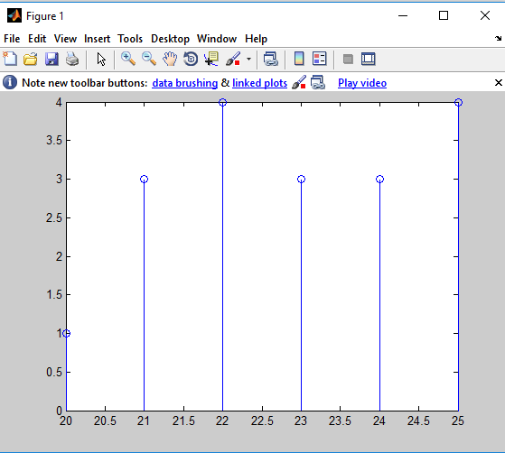
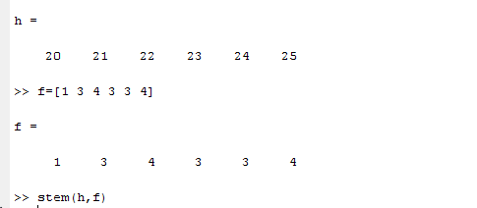
Graphs and Diagrams
Steam and Leaf Plot: stem(h,f)

Slide 17
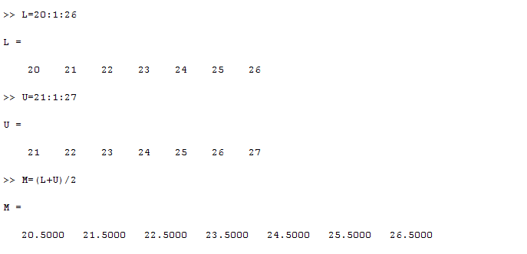
Mid points

Slide 18
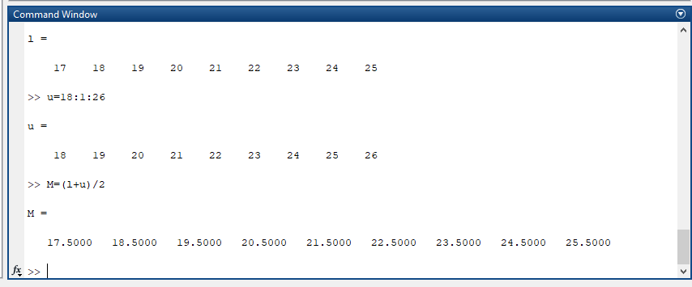
M. Amas Waseem

Slide 19
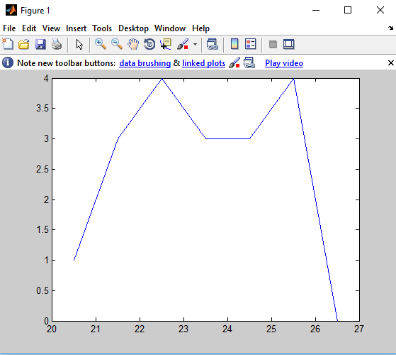
Frequency curve and polygon
Command: plot(M,F)

Slide 20
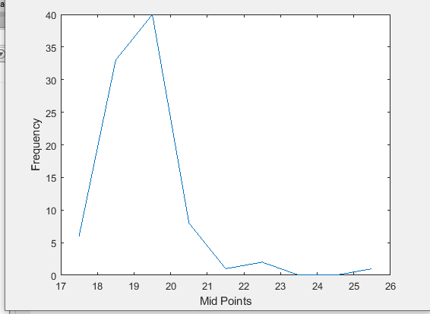
M. Amas Waseem

Slide 21
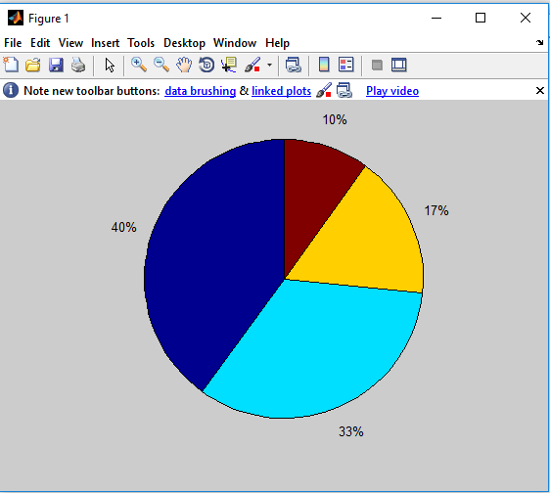
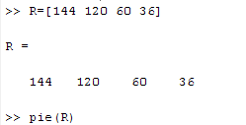
Graphs and Diagrams
Command: pie(R)

Slide 22
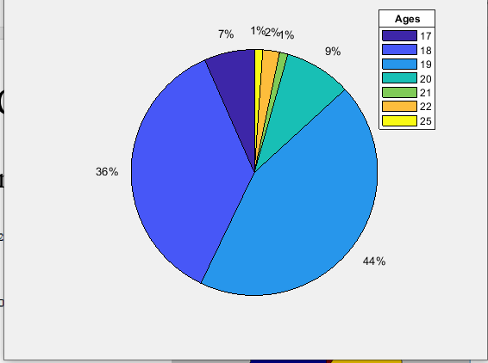
M. Amas Waseem

Slide 23
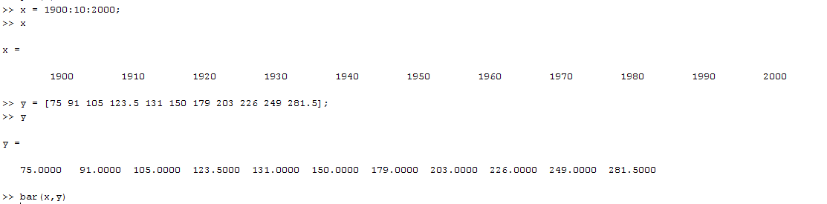
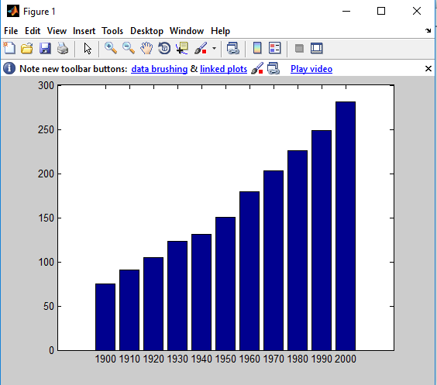
Graphs and Diagrams
Command: bar(x,y)

Slide 24
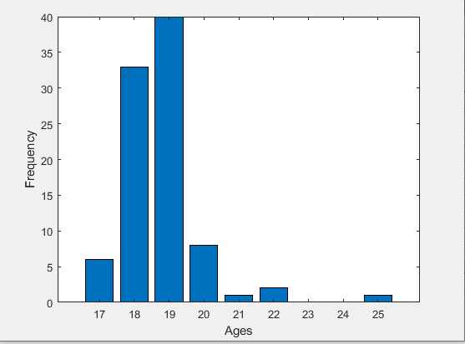
M. Amas Waseem

Slide 25
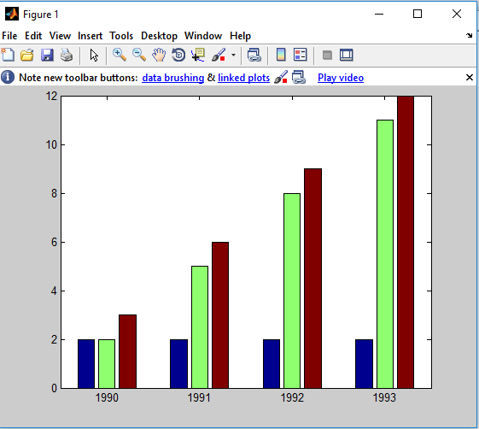
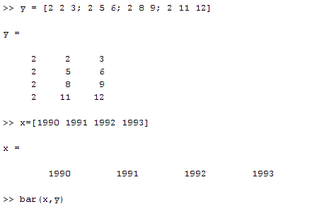
Multiple Bar Diagram
Command: bar(x,y)

Slide 26
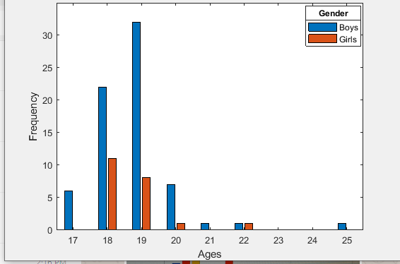
M. Amas Waseem

Slide 27
Assignment Question
Plot a sub-divided bar diagram and a Dot plot in MATLAB

Slide 28
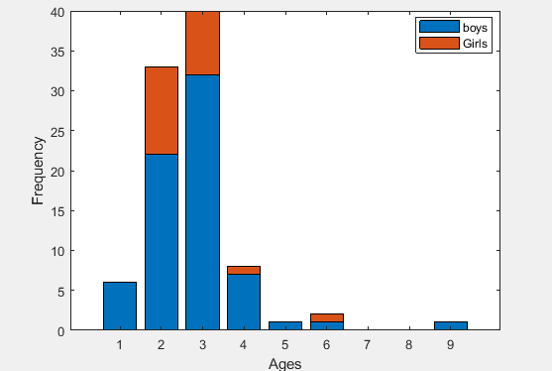
M. Amas Waseem

